Slide 1
TEXT TO SPEECH GUI PROJECT
COURSE CODE : INT 213 SUBMITTED BY:
PRINCE KUMAR

Slide 2
TEXT TO SPEECH
OBJECTIVE
DESCRIPTION OF THE PROJECT
WORK DIVISION
ABOUT THE PROJECT
CONCULSION AND RESULTS
BIBLOGRAPHY

Slide 3
objective
To create a GUI of Text To Speech and understand its work.
To create a user friendly interface which can be accessed by everyone easily.
To understand the working of various modules which are being used to create this interface.
To gather the information related to Text To Speech and implementing in our lives.

Slide 4
WORK DIVISION
Prince Kumar
GUI , PYTHON CODE AND SQL

Slide 5
DESCRIPTION OF THE PROJECT
The Project includes the following :
Attractive Interface
Display of different modules.
Use of Google Text To Speech.
Play and Exit Button

Slide 6
About text to speech
Convert Text Into Speech.
Coded in PYTHON and comes with Graphical User Interface.
Included different Modules and API like gTTS ( Google Text To Speech ).
Included SQL database connectivity that helps the user to store the information and fetch it.

Slide 7
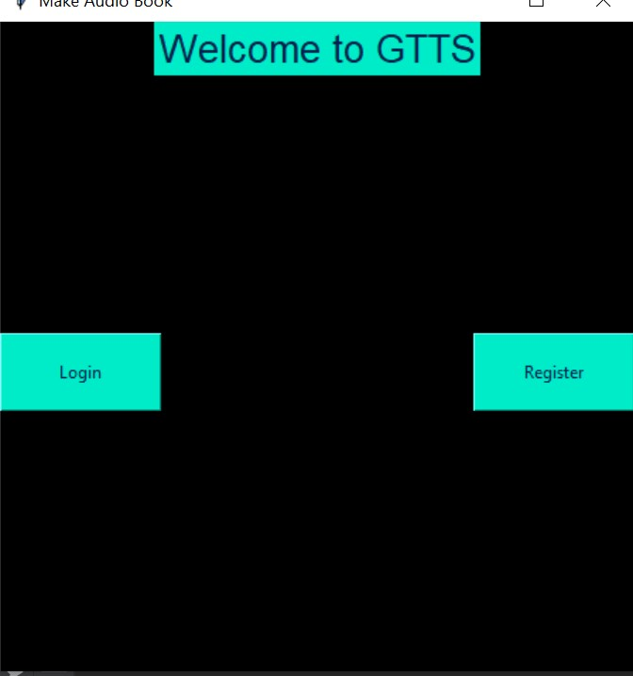
SCREENSHOTS OF GUI

Slide 8
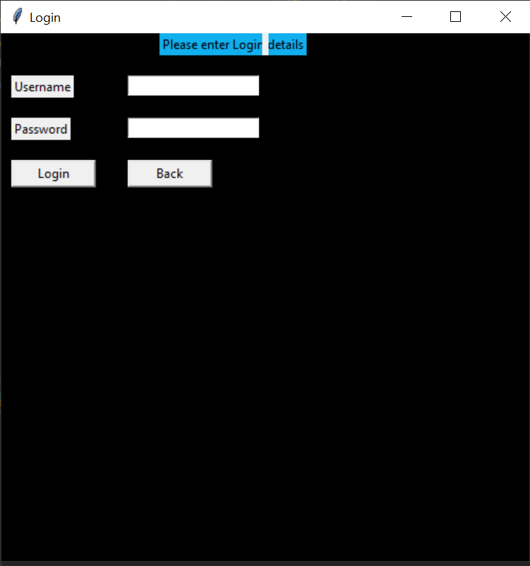

Slide 9
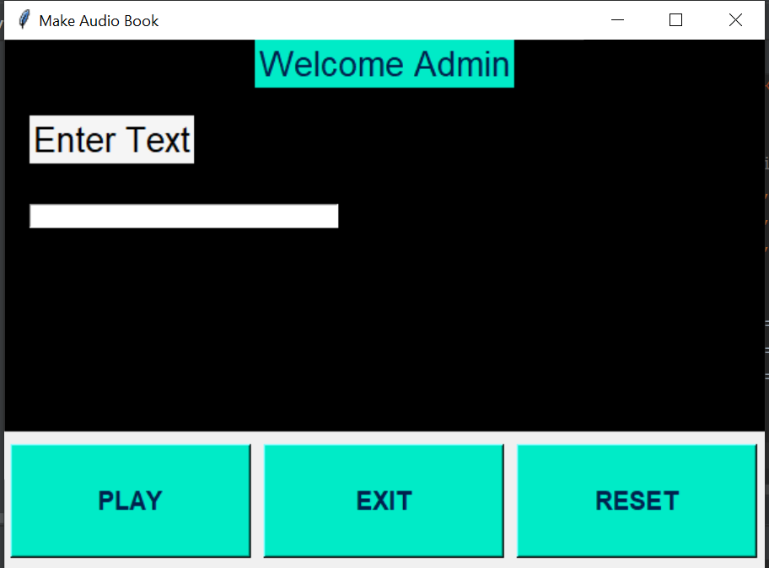

Slide 10
Conclusion and results
The end product is obtained that includes all the mentioned modules discussed earlier.
Learnt to make a GUI using Tkinter in Python.
Learnt to use Google Text To Speech.
Learnt to implement database connectivity using mysql.
The project is capable of convert text into speech.

